Slide 1

Topic: Classification of Matrices: Derogatory vs. Non-Derogatory​
SE Sem IV- 2024-25
Guide
Prof. Madhavi Mali
Department Of Computer Engineering
Watumull Institute Of Engineering And Computer Technology

Slide 2

Group Members:
Kaivalya Narvekar(Roll No:70)
Harshal Nipurte (Roll No:71)
Rudra Pandav (Roll No:72)
Aman Pandey(Roll No:73)
Pranay Pandey(Roll No:74)
Rampravesh Pandit(Roll No:75)
GitHub Link: https://github.com/PranayD2511/Maths-Project.git

Slide 3
Introduction
In linear algebra, matrices are often studied through their polynomials—specifically, the characteristic and minimal polynomials. These provide insight into the matrix’s structure, such as its eigenvalues and the possibility of diagonalization. Based on the relationship between these polynomials, matrices are classified as derogatory or non-derogatory.
A derogatory matrix has a minimal polynomial of lower degree than its characteristic polynomial, indicating repeated eigenvalues with multiple Jordan blocks. In contrast, a non-derogatory matrix has both polynomials identical, typically showing simpler structure and fewer blocks. This classification helps in deeper matrix analysis and applications like control theory, differential equations, and system design.

Slide 4
Challenges & Limitations
• Complex Calculation: Determining the minimal polynomial can be difficult and time-consuming, especially for large or complex matrices.
• Hard to Understand: The concept isn't very intuitive and can be confusing for beginners compared to more familiar topics like eigen values or determinants.
• Dependence on Jordan Canonical Form: Classification often relies on constructing the Jordan form of a matrix, which itself is a complex process and not always numerically stable for computation.
• Limited Practical Usage: While theoretically important, the derogatory/non-derogatory classification is rarely used directly in most applied problems. It is more relevant in abstract algebra, theoretical linear algebra, and control theory.

Slide 5
.
.
.
Importance of the Topic: Applications in Different Fields
• Control Theory: Used in system controllability and observability analysis where the structure of state-space matrices matters.
• Signal Processing: Helps in simplifying systems and analyzing stability using matrix decomposition.
• Differential Equations: Useful in solving systems of linear differential equations by converting them to simpler forms.
• Quantum Mechanics: Assists in studying operators and energy level degeneracies.
• Theoretical Computer Science: Plays a role in automata theory, complexity, and formal verification involving matrix representations.
• Mathematics Education: A fundamental concept in advanced linear algebra courses for deeper theoretical understanding.

Slide 6
Concept of the Topic and Explanation (Steps to Solve)
Matrices are classified as derogatory or non-derogatory based on the relationship between their characteristic and minimal polynomials.
A matrix is derogatory if its minimal polynomial has a lower degree than its characteristic polynomial, indicating repeated eigenvalues with multiple Jordan blocks. A non-derogatory matrix has both polynomials equal, showing a simpler structure and fewer blocks.
This concept helps in understanding a matrix’s complexity, especially in diagonalization and canonical form analysis.
Commonly used for:
Matrix Diagonalization and Simplification
Analyzing System Behavior
Understanding Algebraic Structure

Slide 7
Steps:
First find the characteristic equation of A and solve it.
If the eigenvalues x1​,x2​,x3​ are all distinct then A is non-derogatory.
If x1=x2≠x3​ then find whether the equation (x−x1)(x−x3)=0 is satisfied by A.If it is satisfied by A, then A is derogatory otherwise non-derogatory.
If x1​=x2​=x3​ then find whether the equation (x−x1)=0 is satisfied by A. If it is satisfied by A, then A is derogatory otherwise non-derogatory.

Slide 8
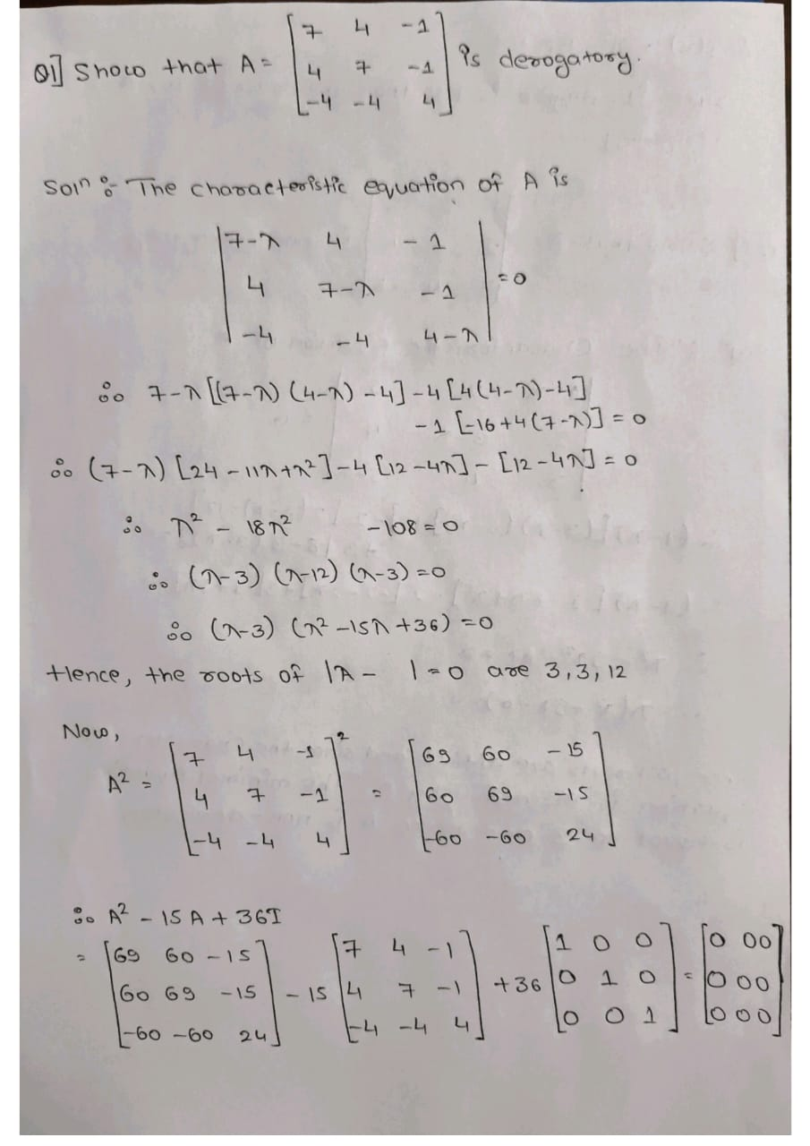
Example 1)

Slide 9
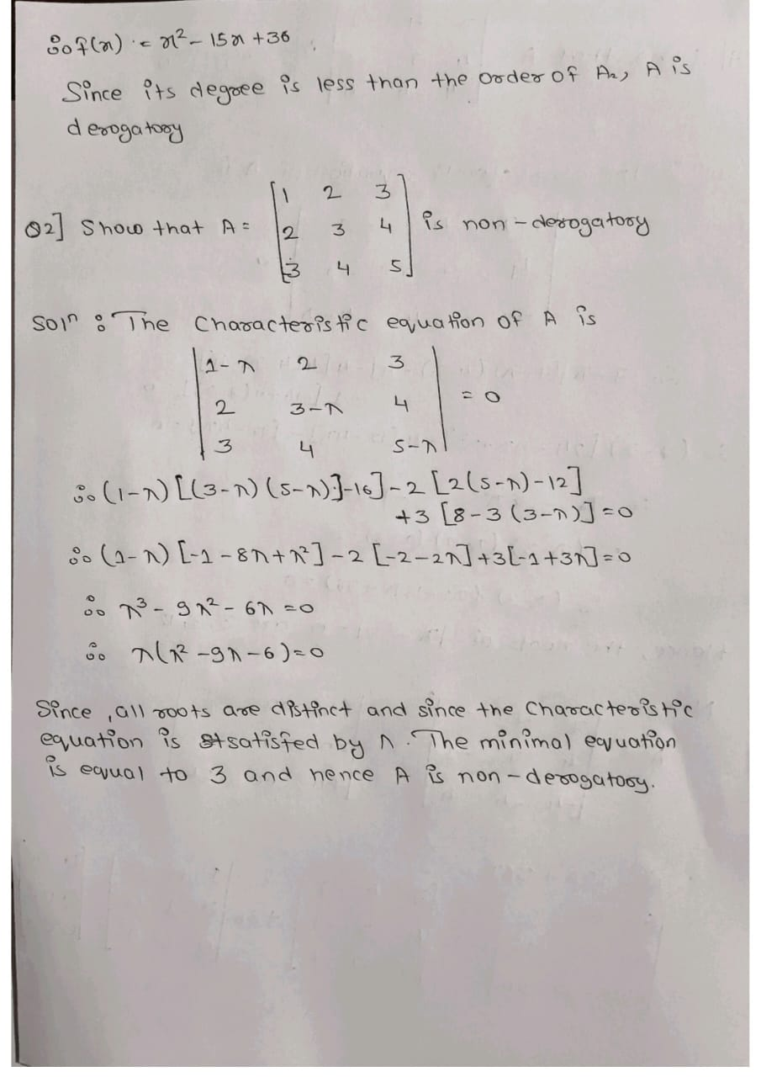
Example 2)

Slide 10
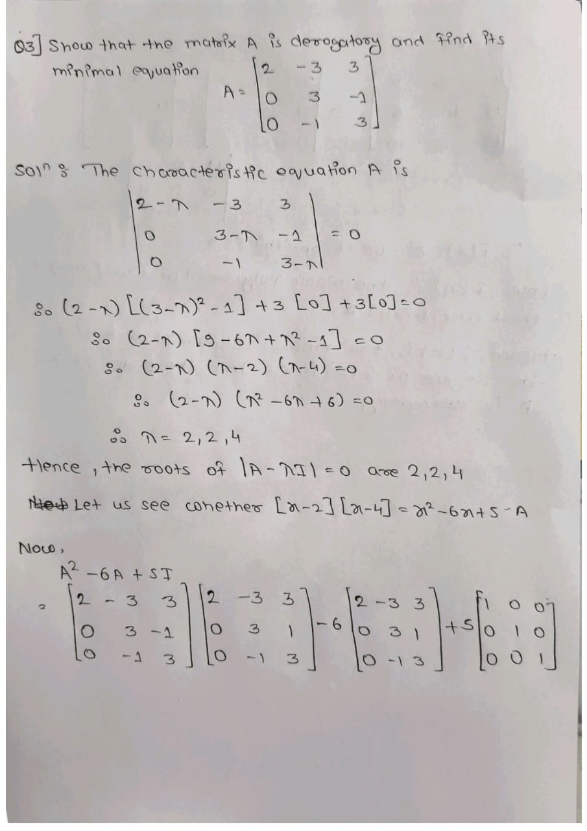
Example 3)

Slide 11
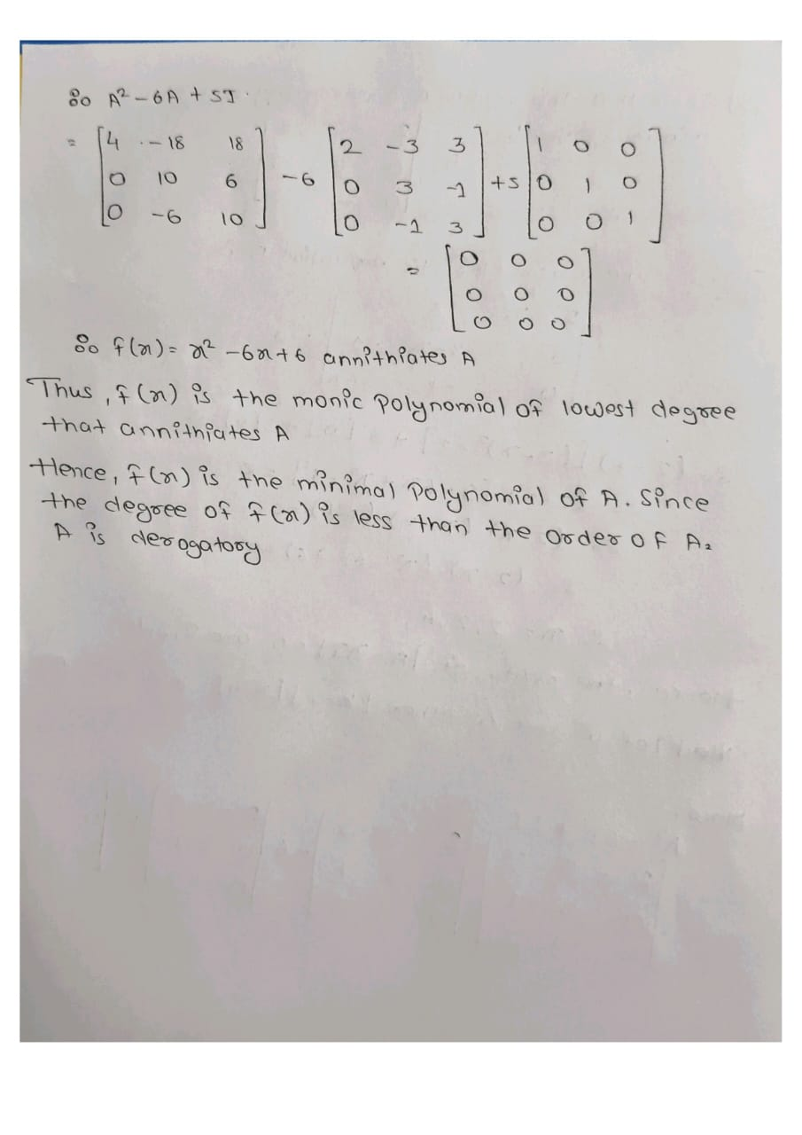
Example 3)

Slide 12
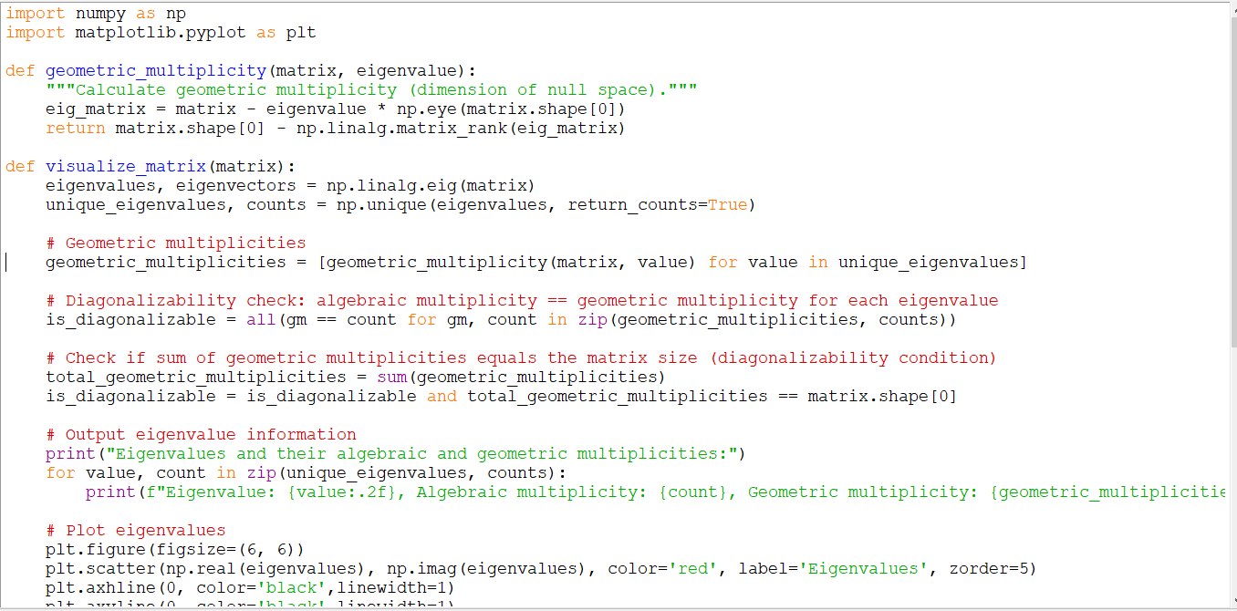
Demonstration

Slide 13
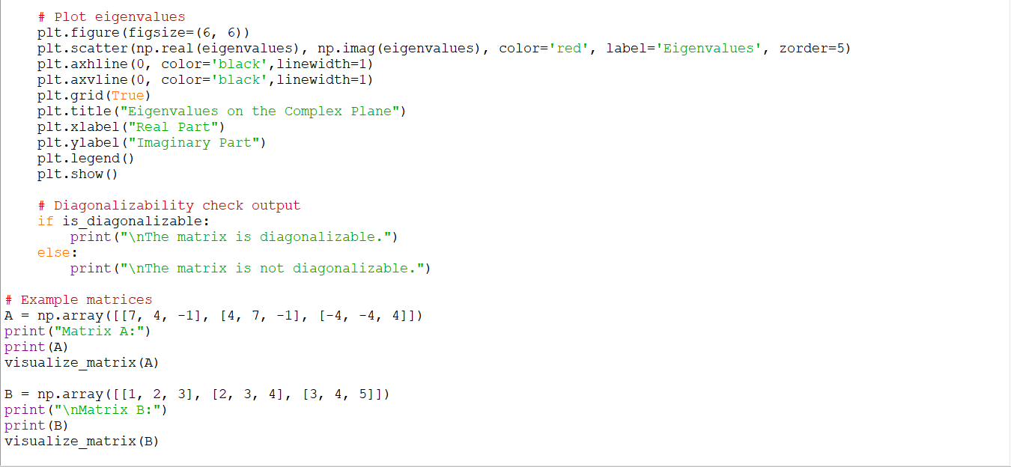
Demonstration

Slide 14
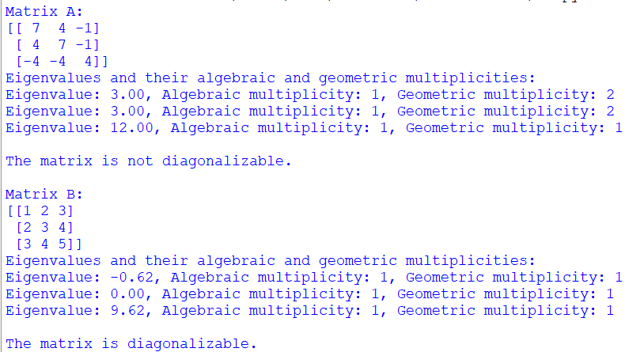
Demonstration

Slide 15
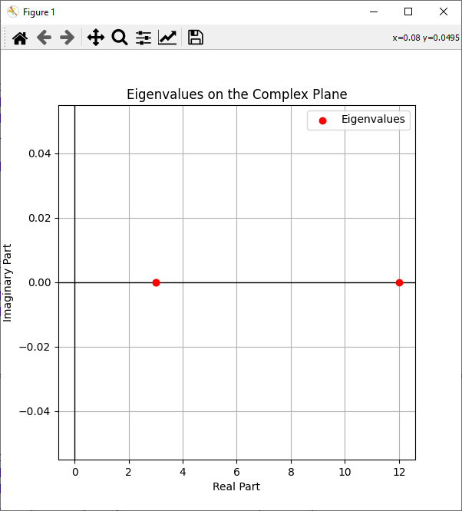
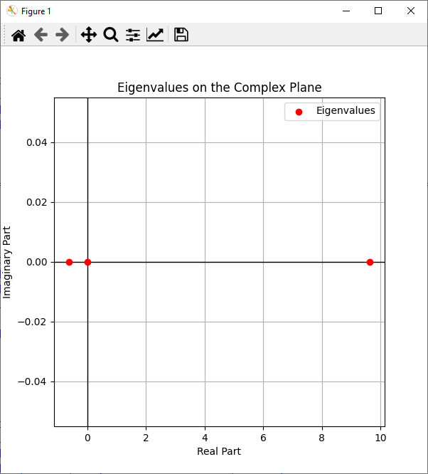
Demonstration

Slide 16
Conclusion
A matrix is derogatory if its minimal polynomial has lower degree than its characteristic polynomial.
A matrix is non-derogatory if its minimal and characteristic polynomials are identical.
The algebraic multiplicity and geometric multiplicity of eigenvalues help determine derogatoriness.
Derogatory matrices have repeated eigenvalues and satisfy reduced polynomial equations.

Slide 17
References
Linear Algebra and Its Applications – David C. Lay, Steven R. Lay, Judi J. McDonald
Matrix Analysis – Roger A. Horn and Charles R. Johnson.
Introduction to Linear Algebra – Gilbert Strang
Linear Algebra – Kenneth Hoffman and Ray Kunze.
Linear Algebra Done Right – Sheldon Axler

